Slide 1
CRUD OOP PHP dan mySQL
Pemrograman Berbasis Web II

Slide 2
Materi
Koneksi Database
Menampilkan List User
Input User Baru
Update User Baru
Delete User Baru

Slide 3
mysqli
mysqli_connect
mysqli_select_db
mysqli_query
mysqli_fetch_all

Slide 4
PHP
include
$_GET[]
$_POST[]
header(“location”)

Slide 5
Buat Koneksi Database (database.php)
<?php
class database
{
public $host = "database";
public $username = "root";
public $pass = "password";
public $db = "docker_php";
public $connect;
function __construct()
{
$this->connect = mysqli_connect($this->host, $this->username, $this->pass);
mysqli_select_db($this->connect, $this->db);
}
}
?>

Slide 6
Menggunakan Koneksi Database (index.php)
<?php
include 'database.php';
$db = new database();
?>

Slide 7
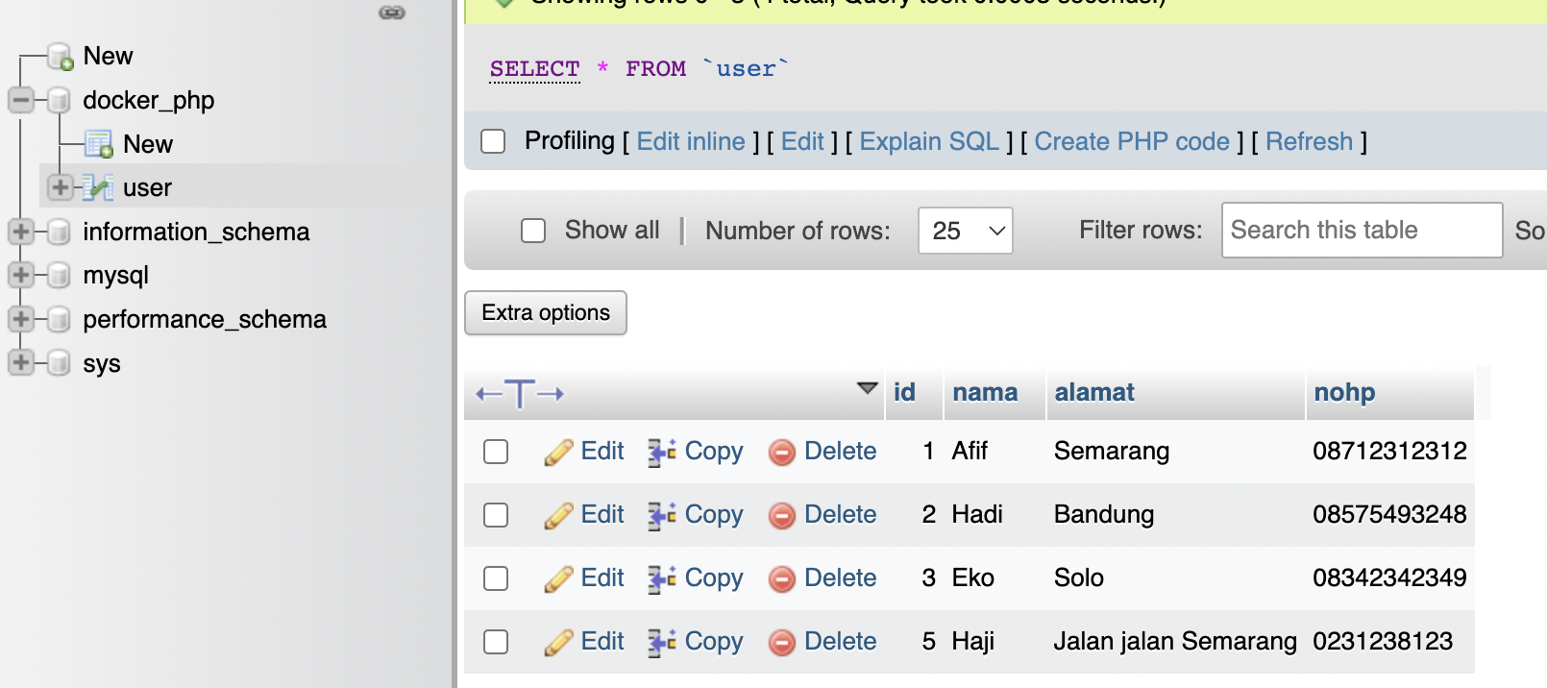
Buat Tabel User dan Isikan Data seperti ini

Slide 8
[READ] Buat Function tampil_data di database.php
<?php
class database
{
……
function tampil_data()
{
$data = mysqli_query($this->connect, "select * from user");
$rows = mysqli_fetch_all($data, MYSQLI_ASSOC);
return $rows;
}
……
}
?>

Slide 9
[READ] Tampilkan data tampil_data di index.php
<?php
$no = 1;
foreach ($db->tampil_data() as $siswa) {
?>
<tr>
<td><?php echo $no++; ?></td>
<td><?php echo $siswa['nama']; ?></td>
<td><?php echo $siswa['alamat']; ?></td>
<td><?php echo $siswa['nohp']; ?></td>
</tr>
<?php
}
?>

Slide 10
[CREATE] Buat Form Input Data dengan buat file input.php
<form action="proses.php?aksi=tambah" method="post">
<div class="mb-3">
<label for="nama" class="form-label">Nama</label>
<input type="text" class="form-control" id="nama" name="nama" placeholder="Nama ..">
</div>
<div class="mb-3">
<label for="alamat" class="form-label">Alamat</label>
<textarea class="form-control" id="alamat" name="alamat" rows="3"></textarea>
</div>
<div class="mb-3">
<label for="nohp" class="form-label">No. HP</label>
<input type="text" class="form-control" id="nohp" name="nohp" placeholder="No. HP ..">
</div>
<input type="submit" class="btn btn-primary" value="Simpan">
</form>

Slide 11
[CREATE] Buat Function input di database.php
<?php
class database
{
……
function input($nama, $alamat, $nohp)
{
mysqli_query($this->connect, "insert into user values(NULL,'$nama','$alamat','$nohp')");
}
……
}
?>

Slide 12
[CREATE] Buat file proses.php
<?php
include 'database.php';
$db = new database();
$aksi = $_GET['aksi'];
if($aksi == "tambah"){
$db->input($_POST['nama'],$_POST['alamat'],$_POST['nohp']);
header("location:index.php");
}
?>

Slide 13
[EDIT] Buat Function edit di database.php
<?php
class database
{
……
function edit($id)
{
$data = mysqli_query($this->connect, "select * from user where id='$id'");
$rows = mysqli_fetch_all($data, MYSQLI_ASSOC);
return $rows;
}
……
}
?>

Slide 14
[EDIT] Buat Tombol Edit di Tabel Data (index.php)
<?php
$no = 1;
foreach ($db->tampil_data() as $siswa) {
?>
<tr>
<td><?php echo $no++; ?></td>
<td><?php echo $siswa['nama']; ?></td>
<td><?php echo $siswa['alamat']; ?></td>
<td><?php echo $siswa['nohp']; ?></td>
<td>
<a class="btn btn-warning btn-sm" href="edit.php?id=<?php echo $siswa['id']; ?>&aksi=edit">Edit</a>
</td>
</tr>
<?php
}
?>

Slide 15
[EDIT] Buat Form Edit Data dengan buat file edit.php
<form action="proses.php?aksi=update" method="post">
<?php
foreach ($db->edit($_GET['id']) as $d) {
?>
<input type="hidden" name="id" value="<?php echo $d['id'] ?>">
<div class="mb-3">
<label for="nama" class="form-label">Nama</label>
<input type="text" class="form-control" id="nama" name="nama" placeholder="Nama .." value="<?php echo $d['nama'] ?>">
</div>
<div class="mb-3">
<label for="alamat" class="form-label">Alamat</label>
<textarea class="form-control" id="alamat" name="alamat" rows="3"><?php echo $d['alamat'] ?></textarea>
</div>
<div class="mb-3">
<label for="nohp" class="form-label">No. HP</label>
<input type="text" class="form-control" id="nohp" name="nohp" value="<?php echo $d['nohp'] ?>" placeholder="No. HP ..">
</div>
<input type="submit" class="btn btn-primary" value="Simpan">
<?php } ?>
</form>

Slide 16
[UPDATE] Buat Function input di database.php
<?php
class database
{
……
function update($id, $nama, $alamat, $nohp)
{
mysqli_query($this->connect, "update user set nama='$nama', alamat='$alamat', nohp='$nohp' where id='$id'");
}
……
}
?>

Slide 17
[UPDATE] Buat file proses.php
<?php
include 'database.php';
$db = new database();
$aksi = $_GET['aksi'];
if($aksi == "tambah"){
$db->input($_POST['nama'],$_POST['alamat'],$_POST['nohp']);
header("location:index.php");
} elseif($aksi == "update"){
$db->update($_POST['id'],$_POST['nama'],$_POST['alamat'],$_POST['nohp']);
header("location:index.php");
}
?>

Slide 18

[DELETE] Buat Tombol Hapus di Tabel Data (index.php)
<?php
$no = 1;
foreach ($db->tampil_data() as $siswa) {
?>
<tr>
<td><?php echo $no++; ?></td>
<td><?php echo $siswa['nama']; ?></td>
<td><?php echo $siswa['alamat']; ?></td>
<td><?php echo $siswa['nohp']; ?></td>
<td>
<a class="btn btn-warning btn-sm" href="edit.php?id=<?php echo $siswa['id']; ?>&aksi=edit">Edit</a>
<a class="btn btn-danger btn-sm" href="proses.php?id=<?php echo $siswa['id'];?>&aksi=hapus">
Hapus
</a>
</td>
</tr>
<?php
}
?>

Slide 19
[DELETE] Buat Function hapus di database.php
<?php
class database
{
……
function hapus($id)
{
mysqli_query($this->connect, "delete from user where id='$id'");
}
……
}
?>

Slide 20
[DELETE] Buat file proses.php
<?php
include 'database.php';
$db = new database();
$aksi = $_GET['aksi'];
if($aksi == "tambah"){
$db->input($_POST['nama'],$_POST['alamat'],$_POST['nohp']);
header("location:index.php");
} elseif($aksi == "update"){
$db->update($_POST['id'],$_POST['nama'],$_POST['alamat'],$_POST['nohp']);
header("location:index.php");
}elseif($aksi == "hapus"){
$db->hapus($_GET['id']);
header("location:index.php");
}
?>

